Slide 1
CSE 417: Artificial Intelligence
Summer 2019
Department of Computer Science and Engineering (CSE)
City University

Slide 2
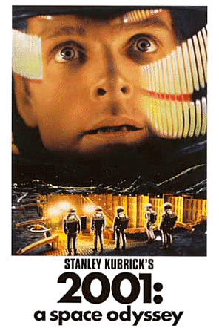
Brief Intro
Course that focuses on the study and design of Intelligent Agents

Slide 3
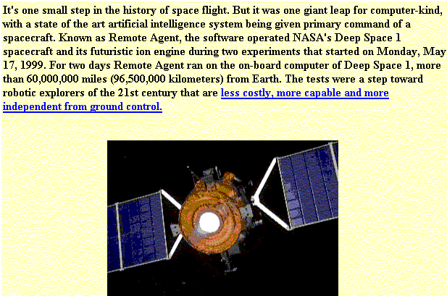
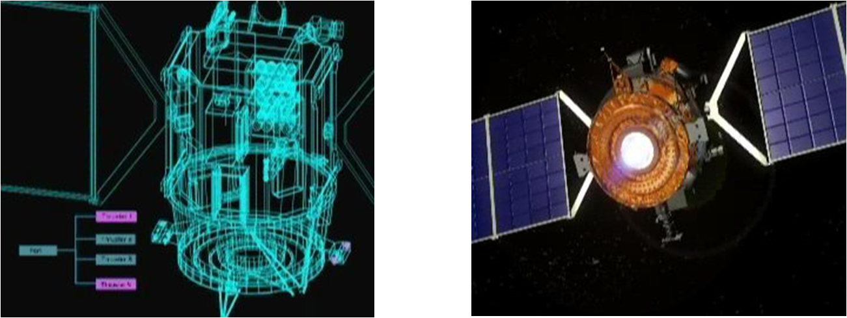
Artificial Intelligence in Real Life
NASA: Deep Space One spacecraft

Slide 4
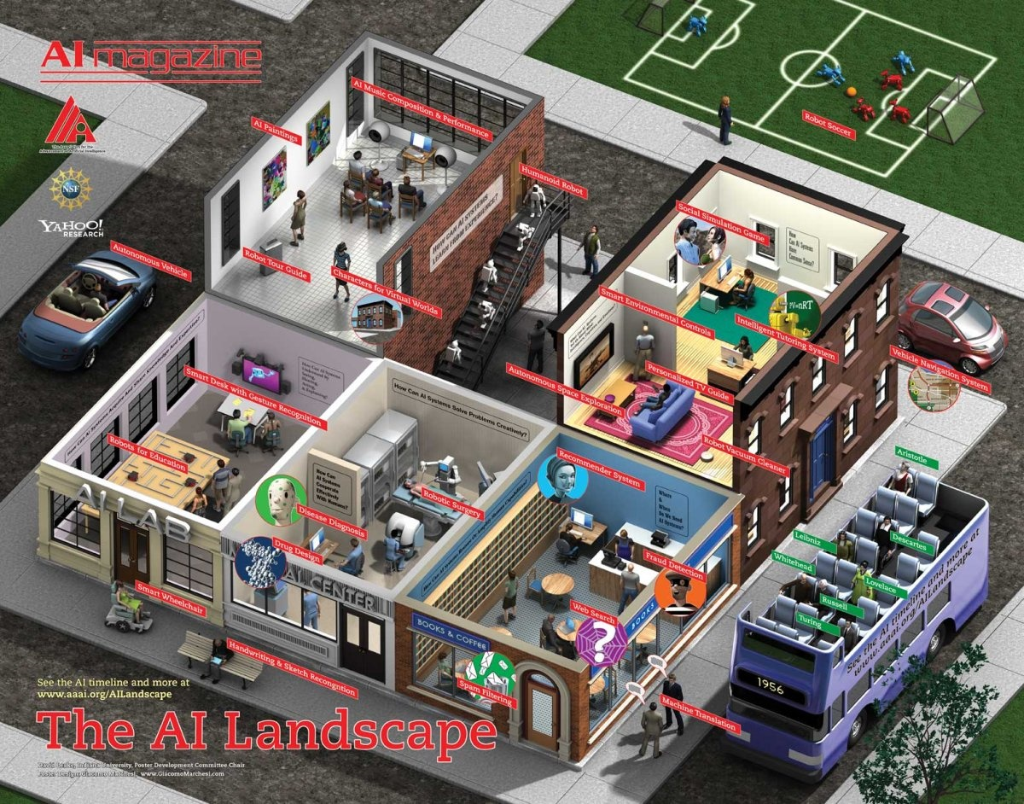
Artificial Intelligence in Real Life
A young science (≈ 50 years old)
  Exciting and dynamic field, impressive success stories
  Lots uncharted territory left
  “Intelligent” in specialized domains
  Many application areas

Slide 5
Slide <number>

Slide 6
This Course
“Breadth" introduction to artificial intelligence.
  It will make a broad coverage of modern AI.
  Focus on core concepts
    Apply to wide variety of applications
    Will mention example applications but without the gory details
Suitable for those with
  no AI background,
  with only one undergraduate course in AI (or Machine Learning).
Designed for computer science students, but is also suitable for students from other programs
  (e.g., cognitive science, engineering)
  Required: familiarity with algorithms, complexity, logic, probability

Slide 7
This Course (cont.)
There are many specialized subfields in AI
Each of them is a separate course (not all offered every year)
    Machine learning
    Computer vision
    Natural language processing
    Robotics
    Intelligent User Interfaces
    ….
If you have already taken two or more AI-related courses, these specialized courses are likely more suitable for you than 502

Slide 8
Textbooks
Required course textbook:
  Artificial Intelligence : A Modern Approach, by Russell and Norvig, 3rd Edition (Prentice-Hall, 2010)
Recommended textbook:
  Artificial Intelligence: Foundations of Computational Agents. by D. Poole and A. Mackworth. Cambridge University Press, 2010
  A selection of research papers from recent conferences/journals in Artificial Intelligence

Slide 9
What is Artificial Intelligence?
Some definitions that have been proposed
  Systems that think like humans
  Systems that act like humans
  Systems that think rationally
  Systems that act rationally

Slide 10
Thinking Like Humans
Model the cognitive functions and behaviors of humans
  Human beings are our best example of intelligence
  We should use that example!

Slide 11
Some Examples
Newell and Simon’s GPS (General Problem Solver, 1961) to test means-end approach as general problem solving strategy
John Anderson’s ACT-R cognitive architecture (http://act-r.psy.cmu.edu/)
  Anderson, J. R. & Lebiere, C. (1998). The atomic components of thought. Erlbaum;
  Anderson, J. R., Bothell, D., Byrne, M. D., Douglass, S., Lebiere, C., & Qin, Y . (2004). An integrated theory of the mind. Psychological Review 111, (4). 1036-1060.
SOAR cognitive architecture (http://sitemaker.umich.edu/soar)
  Newell, A. 1990. Unified Theories of Cognition. Cambridge, Massachusetts: Harvard University Press.

Slide 12
ACT-R Models for Intelligent Tutoring Systems
Intelligent Tutoring Systems (ITS)
Cognitive Science
Computer Science
(AI, HCI)
ILE
Education
Intelligent agents that support human learning and training
By autonomously and intelligently adapting to learners’ specific needs, like good teachers do

Slide 13
ACT-R Models for Intelligent Tutoring Systems
One of ACT-R main assumptions:
  Cognitive skills (procedural knowledge) are represented as production rules:
IF this situation is TRUE, THEN do X
ACT-R model representing expertise in a given domain:
  set of production rules mimicking how a human would reason to perform tasks in that domain
An ACT-R model for an ITS encodes all the reasoning steps necessary to solve problems in the target domain
  Example: rules describing how to solve
  5x+3=30

Slide 14
ACT-R Models for Intelligent Tutoring Systems
Eq: 5x+3=30 ; Goals: [Solve for x]
  Rule: To solve for x when there is only one occurrence, unwrap (isolate) x.
Eq:5x+3=30 ; Goals: [Unwrap x]
  Rule: To unwrap ?V, find the outermost wrapper ?W of ?V and remove ?W
Eq: 5x+3=30; Goals: [Find wrapper ?W of x; Remove ?W]
  Rule: To find wrapper ?W of ?V, find the top level expression ?E on side of equation containing ?V, and set ?W to part of ?E that does not contain ?V
Eq: 5x+3=30; Goals: [Remove “+3”]
  Rule: To remove “+?E”, subtract “+?E” from both sides
Eq: 5x+3=30; Goals: [Subtract “+3” from both sides]
  Rule: To subtract “+?E” from both sides ….
Eq: 5x+3-3=30-3

Slide 15
Cognitive Tutors
ITS that use Act-R models of target domains (e.g. algebra, geometry), in order to
  trace student performance by firing rules and do a stepwise comparison of rule outcome with student action
  Mismatches signal incorrect student knowledge that requires tutoring
These models showed good fit with student performance, indicating value of the ACT-R theory
Cognitive Tutors are great examples of AI success – used in thousands of high schools in the USA (http://www.carnegielearning.com/success.cfm)

Slide 16
Thinking Like Humans
Model the cognitive functions and behaviors of humans
  Human beings are our best example of intelligence
  We should use that example!
  But … really hard to measure thought
    We would have to spend most of our effort on studying how people’s minds operate (Cognitive Science)
    Rather than thinking about what intelligence ought to mean in various domains

Slide 17
What is Artificial Intelligence?
Some definitions that have been proposed
  Systems that think like humans
  Systems that act like humans
  Systems that think rationally
  Systems that act rationally

Slide 18
Acting Like Humans
Turing test (1950)
  operational definition of intelligent behavior
  Can a human interrogator tell whether (written) responses to her (written) questions come from a human or a machine?
No system has yet passed the test
  Yearly competition: http://www.loebner.net/Prizef/loebner-prize.html
  Can play with best entry from 2008: Chatbot Elbot (www.elbot.com)
Is acting like humans really what we want?
  Humans often think/act in ways we don’t consider intelligent
  Why?

Slide 19
So, Why Replicate Human Behavior, Including its “Limitations”?
AI and Entertainment
  E.g. Façade, a one-act interactive drama http://www.quvu.net/interactivestory.net/#publications
Sometime these limitations can be useful, e.g.
  Supporting Human Learning via teachable agents
  (Leelawong, K., & Biswas, G. Designing Learning by Teaching Agents: The Betty's Brain System, International Journal of Artificial Intelligence in Education, vol. 18, no. 3, pp. 181-208, 2008

Slide 20
What is Artificial Intelligence?
Some definitions that have been proposed
  Systems that think like humans
  Systems that act like humans
  Systems that think rationally
  Systems that act rationally

Slide 21
Thinking Rationally
Rationality: an abstract ideal of intelligence, rather than “whatever humans think/do”
  Ancient Greeks invented syllogisms: argument structures that always yield correct conclusions given correct premises
  This led to logic, and probabilistic reasoning which we'll discuss in this course
Is rational thought enough?
  A system that only thinks and doesn’t do anything is quite useless
  Any means of communication would already be an action
  And it is hard to measure thought in the first place …

Slide 22
Acting Rationally
We will emphasize this view of AI
  Rationality is more cleanly defined than human behaviour, so
    it's a better design objective
    in cases where human behaviour is not rational, often we'd prefer rationality
      Example: you wouldn't want a shopping agent to make impulsive purchases!
    And once we have a rational agent, we can always tweak it to make it irrational!
  It's easier to define rational action than rational thought

Slide 23
AI as Study and Design of Intelligent Agents
Intelligent agents: artifacts that act rationally in their environment
  Their actions are appropriate for their goals and circumstances
  There are flexible to changing environments and goals
  They learn from experience
  They make appropriate choices given perceptual limitations and limited resources
This definition drops the constraint of cognitive plausibility
  Same as building flying machines by understanding general principles of flying (aerodynamic) vs. by reproducing how birds fly
Normative vs. Descriptive theories of Intelligent Behavior

Slide 24
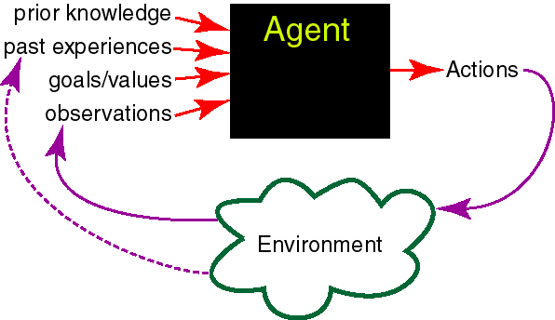
Intelligent Agents in the World
Knowledge Representation
Machine Learning
abilities
Reasoning +
Decision Theory
Natural Language
Generation
Natural Language
Understanding
+
Computer Vision
Speech Recognition
+
Physiological Sensing
Mining of Interaction Logs
+
Robotics
+
Human Computer
/Robot
Interaction

Slide 25
Robots vs. Other Intelligent Agents
In AI, artificial agents that have a physical presence in the world are usually known as robots
  Robotics is the field primarily concerned with the implementation of the physical aspects of a robot
    I.e., perception of and action in the physical environment
    Sensors and actuators
  Agents without a physical presence: software agents
  E.g. desktop assistants, decision support systems, web crawlers, text-based translation systems, intelligent tutoring systems, etc
  They also interact with an environment, but not the physical world
Software agents and robots
  differ in their interaction with the environment
  share all other fundamental components of intelligent behavior

Slide 26
Representation and Reasoning
To use these inputs an agent needs to represent them
knowledge
One of AI goals: specify how a system can
Acquire and represent knowledge about a domain (representation)
Use the knowledge to solve problems in that domain (reasoning)

Slide 27
What do we need to represent ?
The environment /world :
  What different configurations (states / possible worlds) can the world be in, and how do we denote them?
  E.g., Chessboard, Info about a patient, Robot Location
How the world works: we will focus on
  Constraints: sum of electric current into a node = 0
  Causal: what are the causes and the effects of brain disorders?
  Actions’ preconditions and effects: when can I press this button? What happens if I press it?

Slide 28
Representation and Reasoning (R&R) System
problem ⟹ representation ⟹ computation⟹ representation ⟹ solution
A representation language to describe
  The environment
  Problems (questions/tasks) to be solved
Computational reasoning procedures to compute a solution to a problem
  E.g., an answer, sequence of actions
Choice of an appropriate R&R system depends on various dimensions, e.g. properties of
  the environment, the type of problems, the agent, the computational resources, etc.

Slide 29
Representational Dimensions
Environment
Deterministic
Stochastic
Problem Type
Each cell will include a R&R system covered in the course
We’ll start by describing dimensions related to the problem and environment
Static
Sequential
Then we’ll include in each cell R&R system covered in the course
Then we’ll include in each cell the various R&R systems covered in the course, and discuss some more dimensions

Slide 30
Problem Types
  Static: finding a solution does not involve reasoning into the future (time is ignored)
    One-step solution
  Sequential: finding a solution requires looking for a number of steps into the future, e.g.,
    Fixed horizon (fixed number of steps)
    Indefinite horizon (finate, but unknown number of steps)

Slide 31
Problem Types
  Constraint Satisfaction – Find state that satisfies set of constraints (static).
    e.g., what is a feasible schedule for final exams?
  Answering Query – Is a given proposition true/likely given what is known? (static).
    e.g., does the patient suffers from viral hepatitis?
  Planning – Find sequence of actions to reach a goal state / maximize outcome (sequential).
    e.g., Navigate through an environment to reach a particular location

Slide 32
Representational Dimensions
Environment
Deterministic
Stochastic
Problem Type
Constraint Satisfaction
Static
Query
Sequential
Planning

Slide 33






Deterministic vs. Stochastic (Uncertain)
Environment
  Sensing Uncertainty: Can the agent fully observe the current state of the world?
  Effect Uncertainty: Does the agent know for sure what the effects of its actions are?
 | Sensing Uncertainty?
Doctor’s diagnosis
Poker
Chess
 | Effect Uncertainty?
Soccer Player Kick
Teacher’s explanation
Chess

Slide 34
Deterministic vs. Stochastic Domains
Historically, AI has been divided into two camps:
  those who prefer representations based on logic
  those who prefer probability.
However: Some of the most exciting current research in AI is actually building bridges between these camps.

Slide 35
Representational Dimensions
Environment
Deterministic
Stochastic
Problem Type
Each cell will include a R&R system covered in the course
We described dimensions related to the problem and environment
Static
Sequential
Now we include in each cell the various R&R systems covered in the course, and discuss some more dimensions
Then we’ll include in each cell R&R system covered in the course

Slide 36
Representational Dimensions
Environment
Representation
Stochastic
Reasoning
Technique
Deterministic
Problem Type
Arc
Consistency
Constraint Satisfaction
Vars +
Constraints
Search
Static
Belief Nets
Query
Logics
Variable Elimination
Search
Approximate Inference
Temporal Inference
Sequential
STRIPS
Decision Nets
Planning
Variable Elimination
Search
Markov Processes
Value Iteration

Slide 37
Other Representational Dimensions
We've already discussed:
Problem Types (Static vs. Sequential )
Deterministic versus stochastic domains
Some other important dimensions
Knowledge given versus knowledge learned from experience
Representation scheme: Explicit state or features or relations
Flat or hierarchical representation
Goals versus complex preferences
Single-agent vs. multi-agent

Slide 38
Knowledge given vs. knowledge learned from experience
The agent is provided with a model of the world once and far all vs.
The agent can learn how the world works based on experience
  in this case, the agent often still does start out with some prior knowledge
This course will provide an intro to
  Supervised Machine Learning
  Unsupervised Machine Learning
  Reinforcement Learning

Slide 39
Explicit State vs Features
How do we model the environment?
You can enumerate the states of the world.
A state can be described in terms of features
  Often a more natural description
  30 binary features (also called propositions) can represent
2³⁰=1,073,741,824 states

Slide 40
Explicit State vs Features
Mars Explorer Example
Weather
Temperature
Longitude
Latitude
One possible state
Number of possible states (mutually exclusive)
{S, C}
[-40, 40]
[0, 359]
[0, 179]
{S, -30, 320, 210}
2 x 81 x 360 x 180

Slide 41
Explicit State vs. Features vs. Relations
States can be described in terms of objects and relationships
There is a proposition for each relationship on each tuple (n > 1) of objects
University Example:
  Students (S) = {s1, s2, s3, …, s200)
  Courses (C) = {c1, c2, c3, …, c10}
  Registered (S, C)
  Number of Relations: 1
  Number of Propositions:
  Number of States:
200*10
2²⁰⁰⁰

Slide 42
Flat vs. hierarchical
Should we model the whole world on the same level of abstraction?
  Single level of abstraction: flat
  Multiple levels of abstraction: hierarchical
Example: Planning a trip from here to a resort in Cancun
Going to the airport
Take a cab
Call a cab
Lookup number
Dial number
Ride in the cab
Pay for the cab
Check in
….
This course: mainly flat representations
  Hierarchical representations required for scaling up.

Slide 43
Goals vs. (complex) preferences
An agent may have a goal that it wants to achieve, e.g.,
  there is some state or set of states that the agent wants to be in
  there is some proposition or set of propositions that the agent wants to make true
An agent may have preferences
  a preference/utility function describes how happy the agent is in each state of the world
  Agent's task is to reach a state which makes it as happy as possible
Preferences can be complex
This course: goals and simple preferences
What beverage to order?
The sooner I get one, the better
Cappuccino yummier than Espresso, but…

Slide 44
Single-agent vs. Multi-agent domains
Does the environment include other agents?
If there are other agents whose actions affect us, it can be useful to explicitly model
  their goals and beliefs,
  how they react to our actions
Other agents can be: cooperative, competitive, or a bit of both
This course: only single agent scenario

Slide 45
Summary
Would like most general agents possible, but in this course we need to restrict ourselves to:
Flat representations (vs. hierarchical)
Knowledge given and intro to knowledge learned
Goals and simple preferences (vs. complex preferences)
Single-agent scenarios (vs. multi-agent scenarios)
We will look at
Deterministic and stochastic domains
Static and Sequential problems
As see examples of representations using
Explicit state or features or relations

